Slide 1

Retail Banking Transaction Analysis
Presented by :
Pournami Saidula

Slide 2
About Me
I’m Pournami Saidula, an aspiring Data Analyst with an interest in Data Analytics and Data Science. I have skills in Python, SQL, Microsoft Excel, Power BI, and Data Analysis.
I built a Retail Banking Transaction Analysis project using MySQL to analysis customer, account, transaction, loan, and card data and generate meaningful business insights.
Work Experience : Fresher​
LinkedIn: www.linkedin.com/in/pournamisaidula

Slide 3
Agenda​
Project overview
Business Scenario
Business Objectives
Dataset & Database Overview
ER Diagram & Database Structure
Analysis of the Objectives
Overall Key Findings
Business Recommendations
Conclusion

Slide 4
Project overview:
Designing and understanding the retail banking database.
Writing SQL queries to analyze customer behavior and banking operations.
Identifying trends in transactions, loans, cards, and branch performance.
Providing insights and recommendations to improve business performance.

Slide 5
Business scenario:
A retail bank has many customers, accounts, branches, loans, cards, and transactions.
The management wants to understand how customers use banking products and how the bank is performing.
As a Data Analyst, we analyse the available data and provide useful information to help the bank make better decisions.

Slide 6
Business objectives:
The main objectives of this project are to understand:
Customer profiles and segments
Account usage and branch activity
Transaction patterns
Loan performance and repayment behaviour
Card usage and customer product engagement.

Slide 7
Data Set& Database Overview:
The project contains 7 tables with banking information.
Table | Records
Customers | 500
Accounts | 700
Branches | 40
Loans | 300
Loan Payments | 2000
Cards | 600
Transactions | 5000

Slide 8
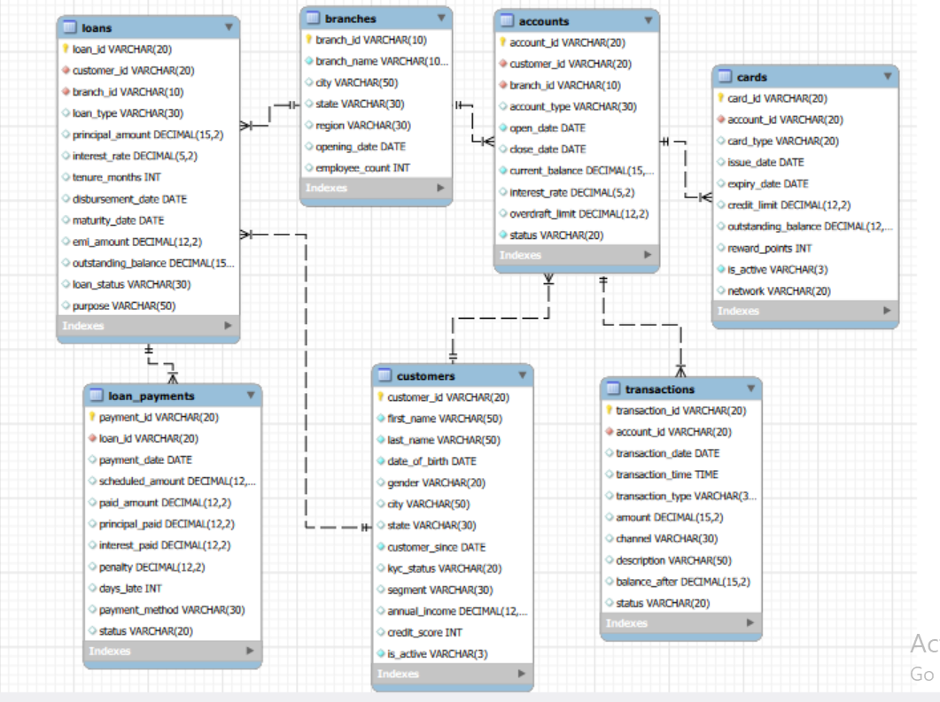
ER Diagram & Database Structure:

Slide 9
Analysis of Business Objectives:
OUTPUT:
segment | Total_customers
Business | 97
Premium | 76
Retail | 80
Senior | 73
Student | 100
Wealth | 74
Customer profiles and segments
select segment,count(*) as total_customers from customers
group by segment;
Account usage and branch activity
OUTPUT:
Account_type | Total_accounts
IRA | 136
Certificate of Deposit | 118
Savings | 117
Business Checking | 116
Money Market | 110
Checking | 103
select account_type,count(*) as total_accounts from accounts
group by account_type
order by total_accounts desc;

Slide 10
Analysis of Business Objectives:
OUTPUT:
Transaction patterns
Transaction_type | Total_transaction
Transfer | 858
ATM Withdrawal | 857
Interest | 855
Debit | 828
Credit | 818
Fee | 784
select transaction_type,count(*)
as total_transactions from transactions
group by transaction_type
order by total_transactions desc;
Loan performance and repayment behaviour
OUTPUT:
Loan_type | Total_loans
Education | 64
Business | 52
Credit Builder | 49
Auto | 48
Personal | 45
Home | 42
select loan_type,count(*) as total_loans from loans
group by loan_type
order by total_loans desc;

Slide 11
Analysis of Business Objectives:
Card usage and customer product engagement
select card_type,count(*) as total_cards from cards
group by card_type
order by total_cards desc;
OUTPUT:
Card_type | total_cards
Debit | 358
Credit | 242

Slide 12
Overall Key Findings:
Identified different customer segments.
Found commonly used account and transaction types.
Identified active customers and branches.
Studied loan repayment and late payments.
Understood card usage and customer product usage.
Found useful patterns from the banking data.

Slide 13
Business Recommendations:
Provide better services based on customer needs.
Give suitable offers to customers using multiple products.
Monitor customers with delayed loan payments.
Improve services in less active branches or channels.
Encourage customers to use suitable banking products.

Slide 14
Conclusion:
Analysed banking data using MySQL and SQL.
Studied customers, accounts, transactions, loans, and cards.
Found useful patterns and customer behaviour.
Converted data into meaningful business insights.
The insights can help the bank make better decisions.

Slide 15

THANK YOU

